Slide 1
GNS3 - rConfig
Rconfig - device creation and GNS3 - Router Configuration

Slide 2
Prerequisites
VirtualBox VM
Virtual Cent OS7 in Virtual Box
Rconfig application 3.8.6 version installed in Cent OS7
GNS3 Version 2.0.3

Slide 3
VirtualBox VM
Download Oracle VirtualBox VM from the following URL

Slide 4
GNS3
Download GNS3 from the below URL and follow the installation procedure.

Slide 5
Cent OS7 and rConfig
Install Cent OS7 in VirtualBox VM as mentioned in the below document
Install rConfig 3.8.6 version in Cent OS7 as mentioned the below document

Slide 6
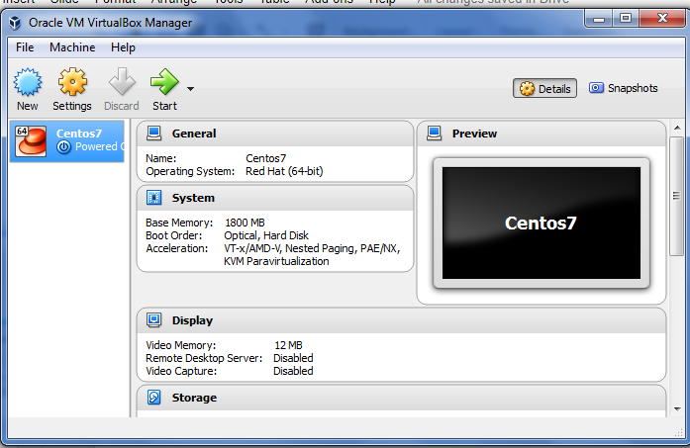

Slide 7
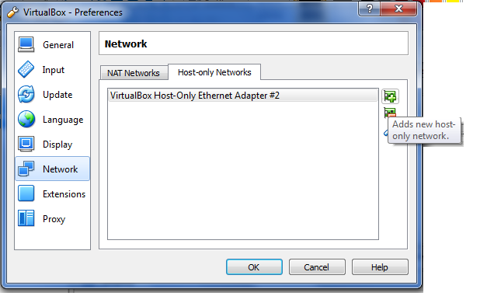
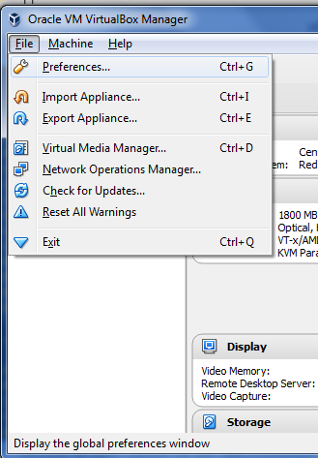
Add new network adapter interface
VirtualBox Host-Only Ethernet Adapter#2
By selecting Adds new host only network icon

Slide 8
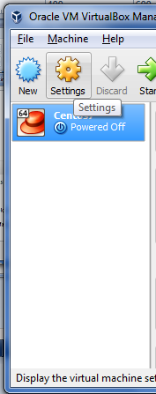
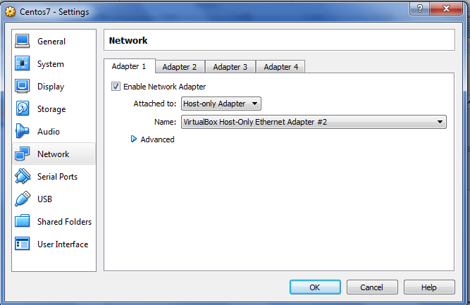
Goto Network Settings and choose
Attached to : Host-only Adapter
Name: VirtualBox Host-only Ethernet Adapter #2

Slide 9
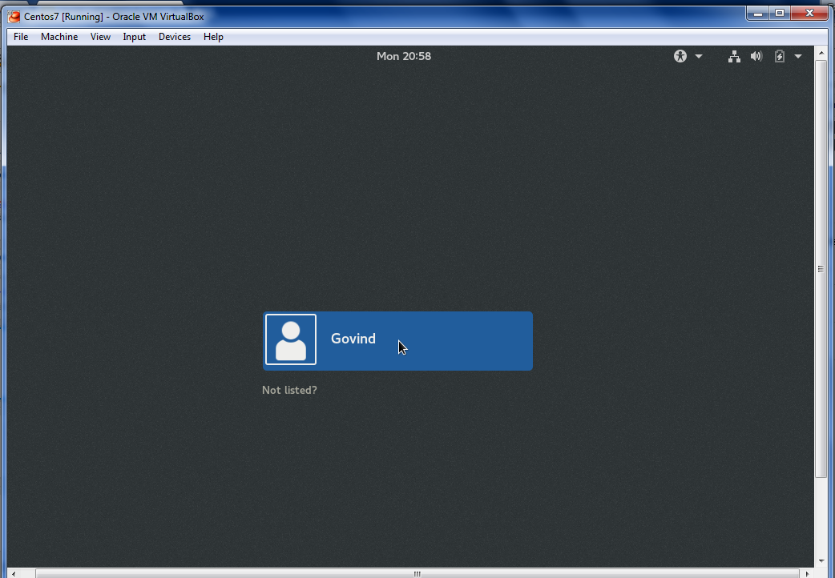
Start CentOS
And Login
As root user

Slide 10
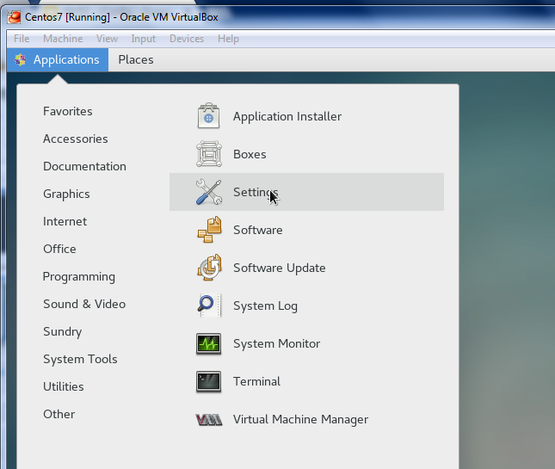
Open the
Settings -> Network

Slide 11
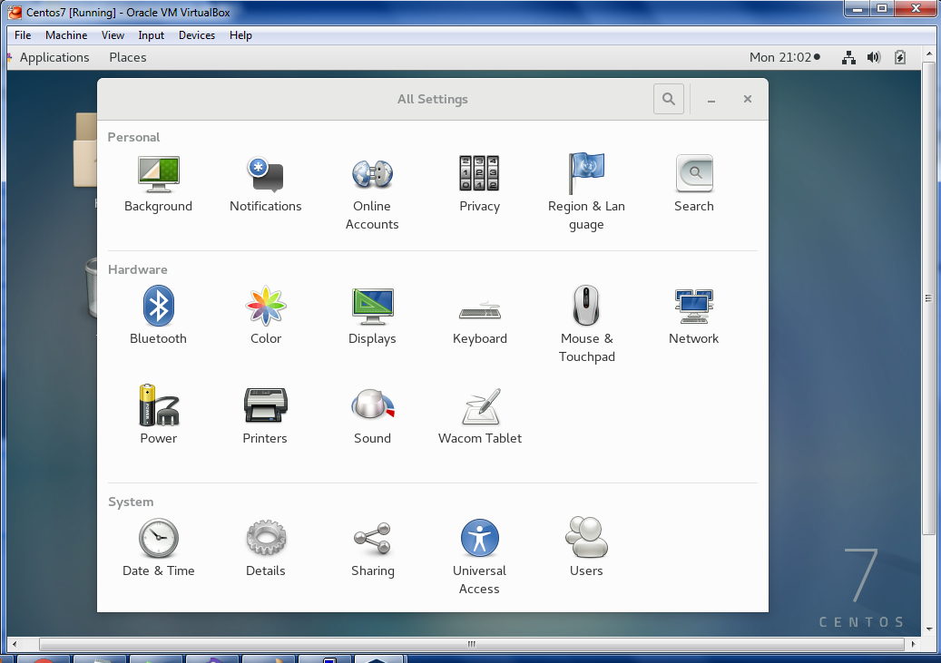
Open the
Network option

Slide 12
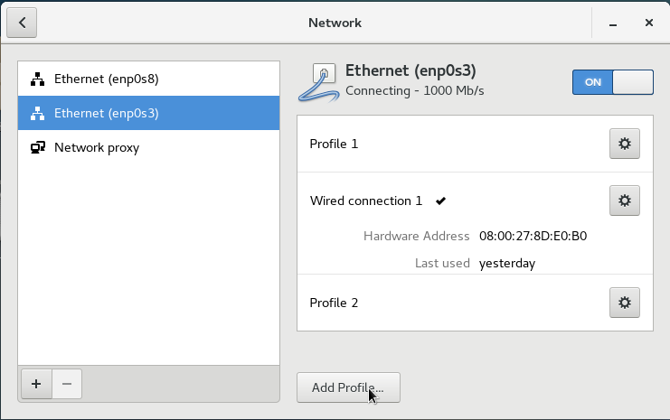

Slide 13
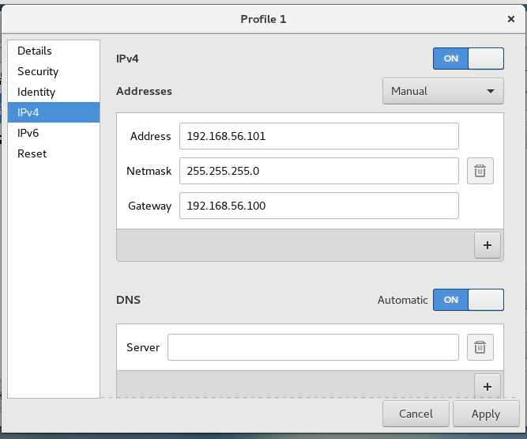

Slide 14
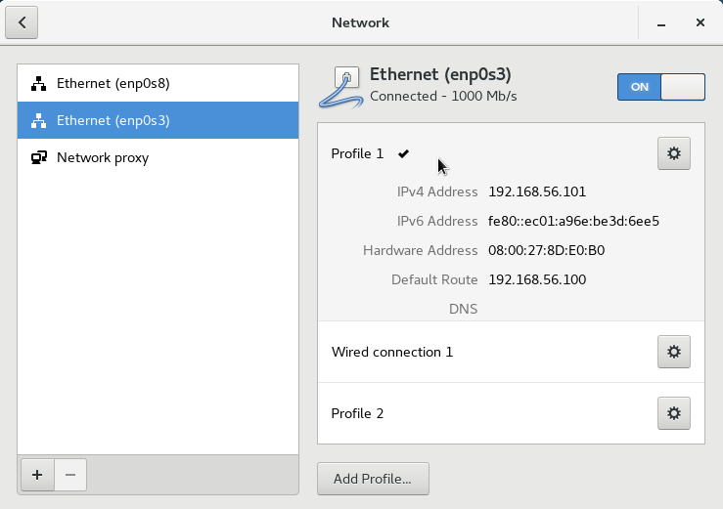

Slide 15
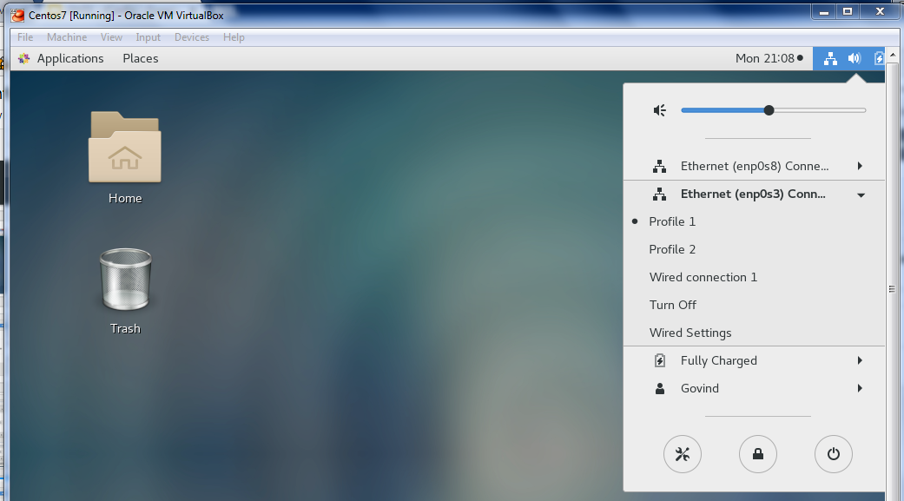
Ensure that Profile1 is got selected
And enabled

Slide 16
New profile has been created with IP address 192.168.56.101.
You can set an valid IP address as your wish
We will use this ip address to communicate with GNS3 routers

Slide 17
GNS3 - Router Configuration
Open GNS3 software
Open new project and name it as your wish [ eg: RouterConf ]
Follow the Below given screen shots

Slide 18
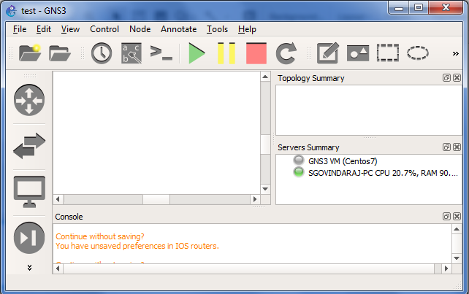

Slide 19
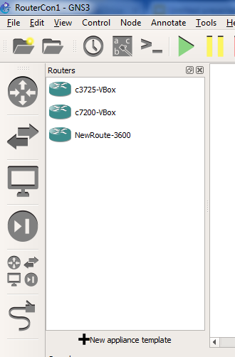
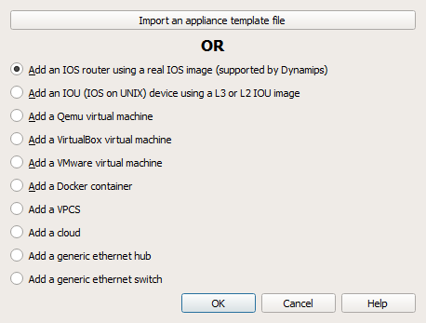
Add New Router Image
Notes:
Create New Router using IOS

Slide 20
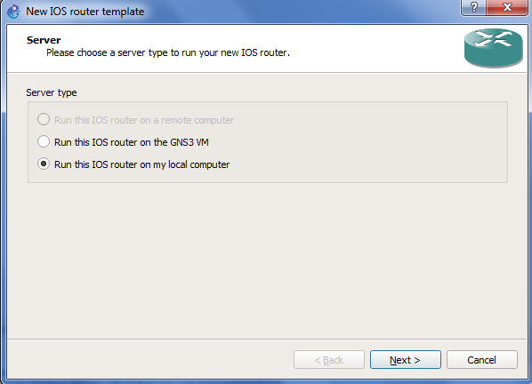

Slide 21
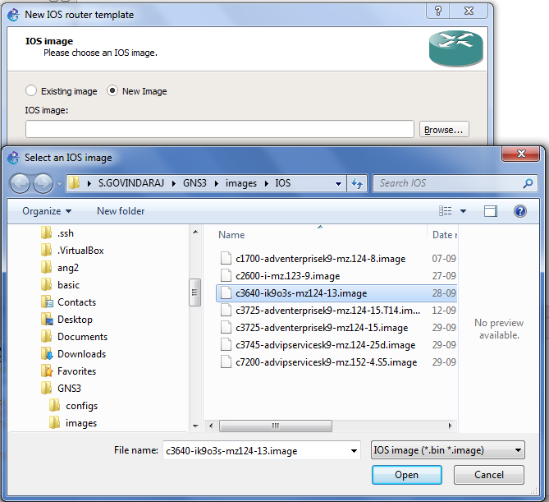
Choose any Router image ios, here I have choose c3640-ik9o3s-mz124-13.image ios
Notes:
Choose any Router image ios, here I have choose c3640-ik9o3s-mz124-13.image ios

Slide 22
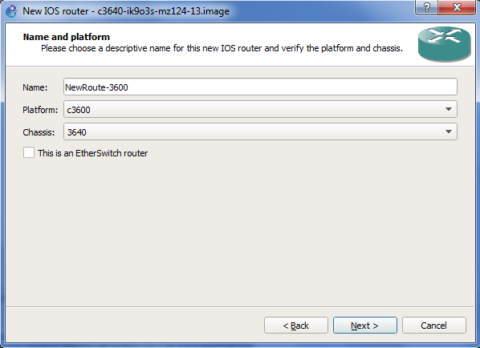
Change Name of router as your wish,
Here I named it as NewRoute-3600

Slide 23
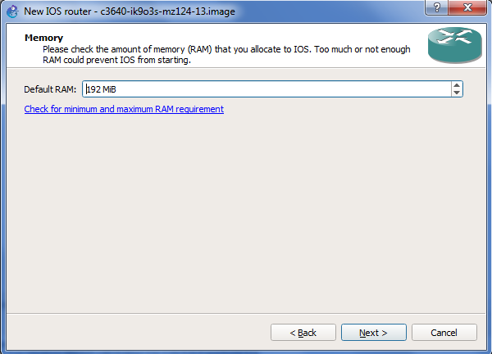
Change the default RAM size into 256MB as it requires 256MB for this router.
Your can check the required RAM size from the given link

Slide 24
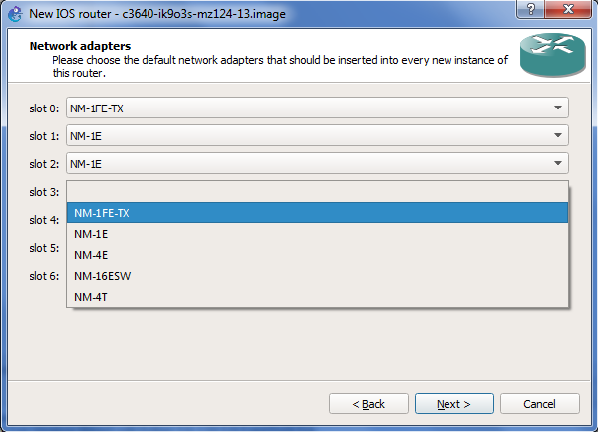
Choose the Adapters for each slots from the listing

Slide 25
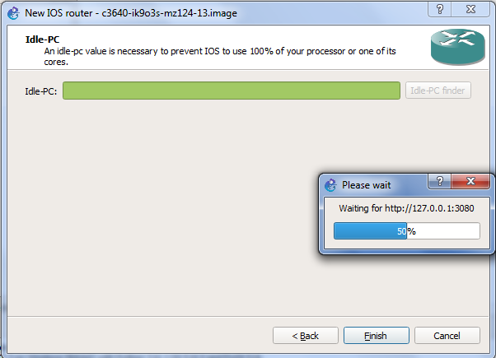
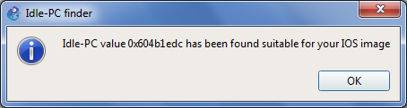
0x604b1edc
Click the Idle-PC finder button to generate Idle-PC value. It will be needed to keep device idle until the device is used after start

Slide 26
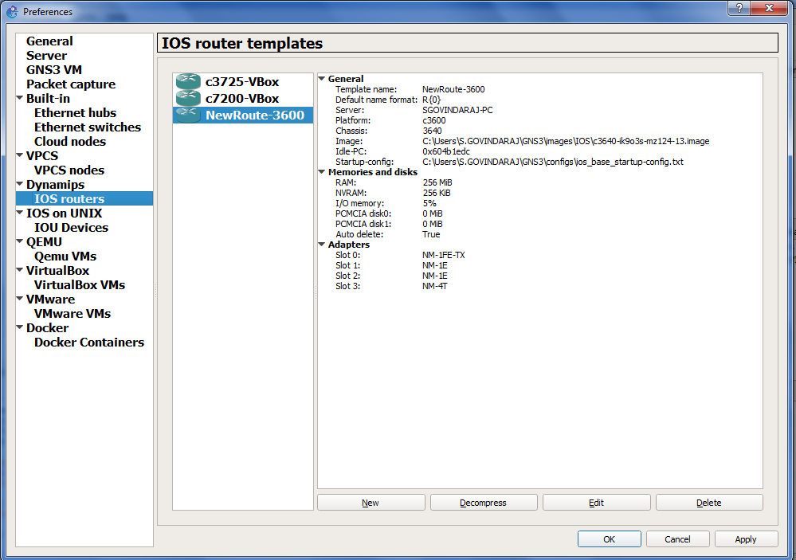
Newly created router is listed here Click OK/Apply it will be available in the devices pallet for usage

Slide 27
Newly created router NewRoute-3600 is now available for usage.

Slide 28
Create New Project

Slide 29
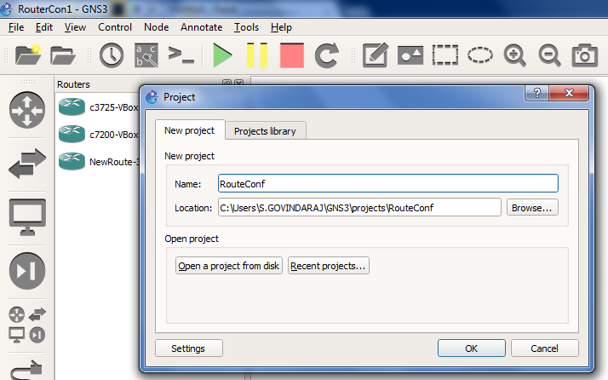
Click New Project:
Rename it into RouteConf

Slide 30
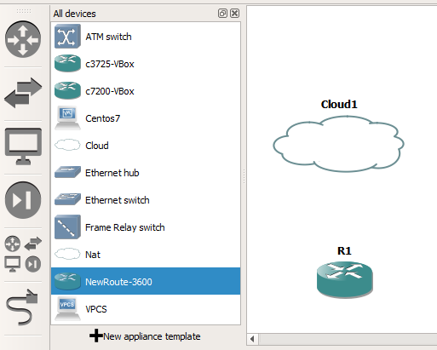
Drag and drop the Cloud and Router icons from the All Devices pannel

Slide 31
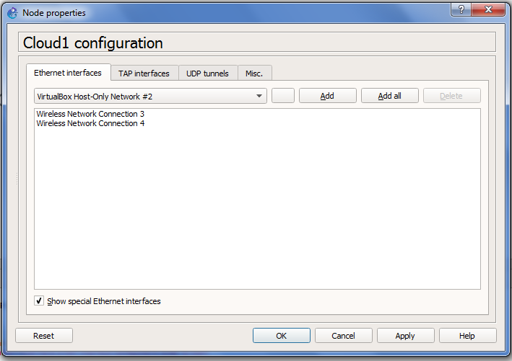
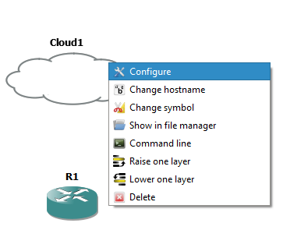
Choose VirtualBox Host-Only Network #2 option from the drop down after clicking below the show special Ethernet interfaces
Note: This VirtualBox Host-Only Network #2 options is created in the VirtualBox VM centOS settings -> Network -> Set adapter sections

Slide 32
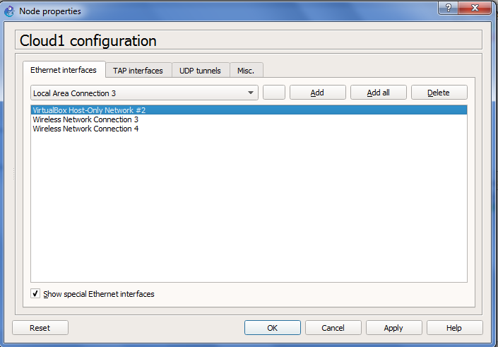
Click Add to get the VirtualBox Host-Only Network#2 in the Ethernet interfaces options list and Click Apply , Ok

Slide 33
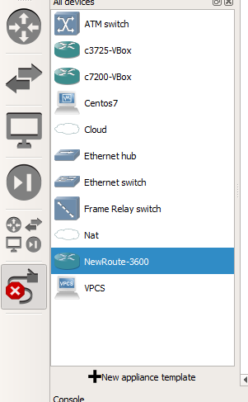
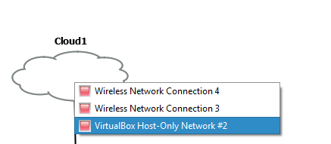
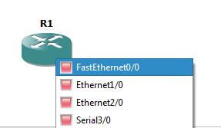
Get the Add Link and link the router and cloud as selected in the picture
Add Link

Slide 34
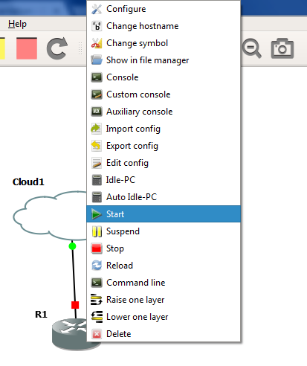
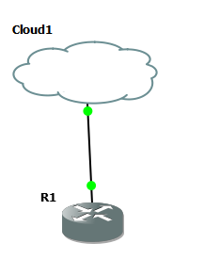
After connecting the router and cloud
Right click the router and select Start to enable the router
It will become like this

Slide 35
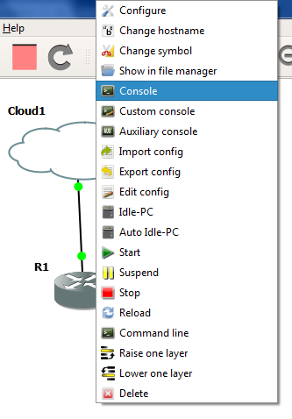
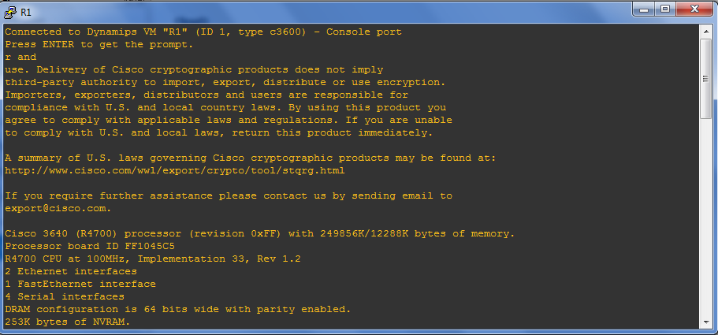
Right click the Router icon and select Console option to configure router properties
It Opens the R1 commad prompt as like this. Here you have do the configurations

Slide 36
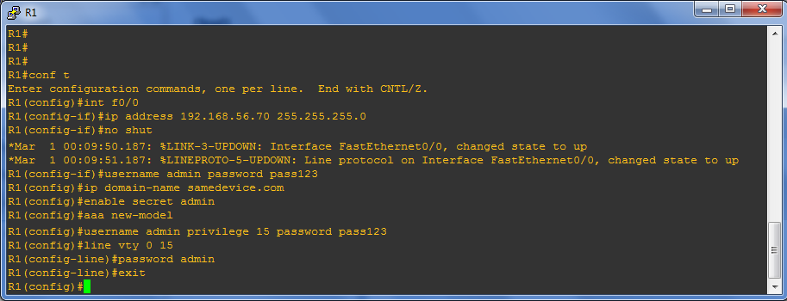
Router Connection using Telnet

Slide 37
Sample Configuration Text
Red colored text are as your wish
conf t
int f0/0
ip address 192.168.56.70 255.255.255.0
no shut
username vinod password pass123
ip domain-name redhated.com
enable secret pass123
aaa new-model
username vinod privilege 15 password pass123
line vty 0 15
password pass123
exit

Slide 38
Communicate Router to Cent OS
Try to ping from R1 terminal to Cent OS profile 1
And
Try to ping from Cent OS profile terminal to R1 router

Slide 39
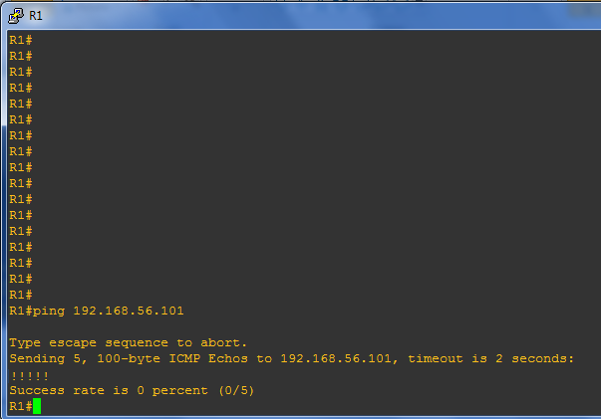
Open the R1 terminal and
Enter the below ping command
R1# ping 192.168.56.101
Ping to CentOS 7 profile1 IP address 192.168.56.101
!!!!! => Denotes successful
…. => Denotes failure

Slide 40
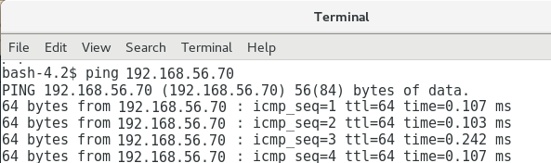
Ping from CentOS
Terminal
Ping 192.168.56.70
Returns responses

Slide 41
rConfig Device Management

Slide 42
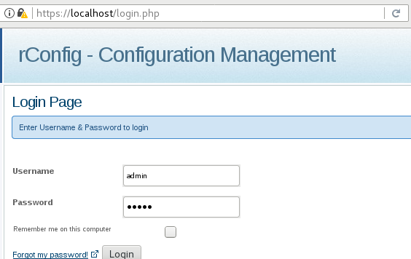

Slide 43
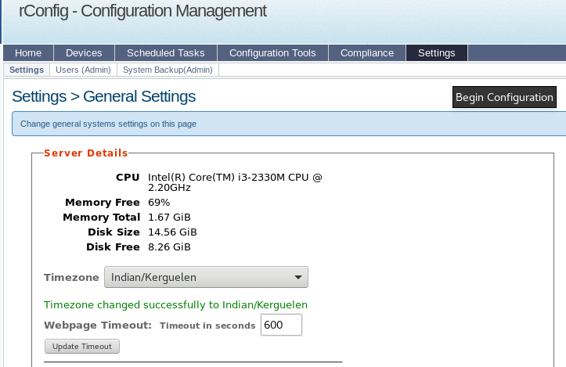
Set the default
Timezone values
As per your country
and area
Note: if the timezone
Is not set, any ajax responses
In the application wouldn’t
display on the window even
Though the task run successfully

Slide 44
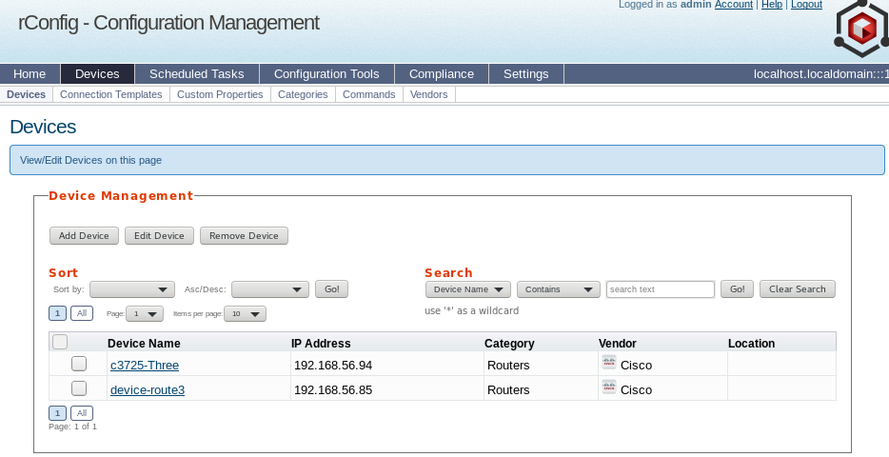

Slide 45
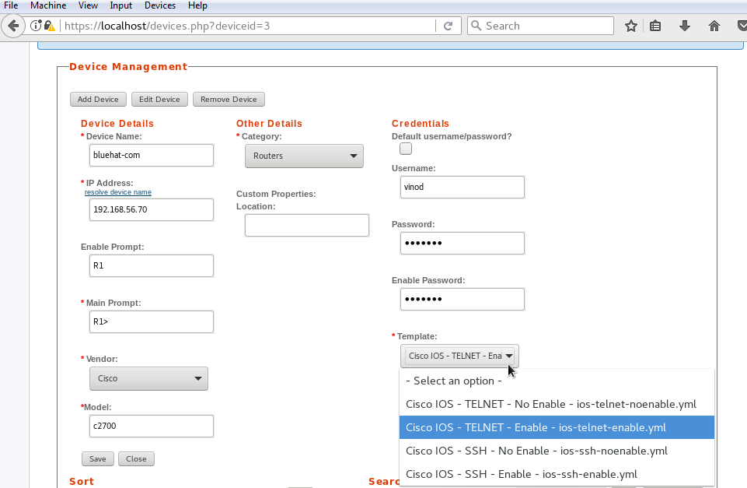
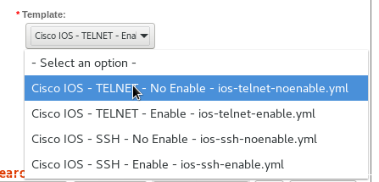
pass123

Slide 46
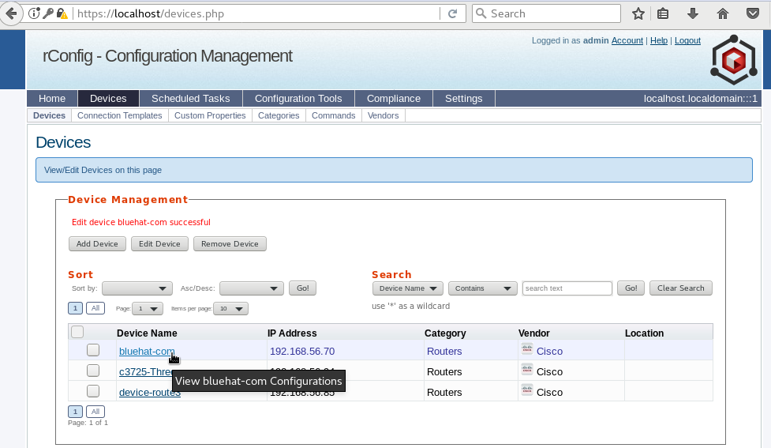

Slide 47
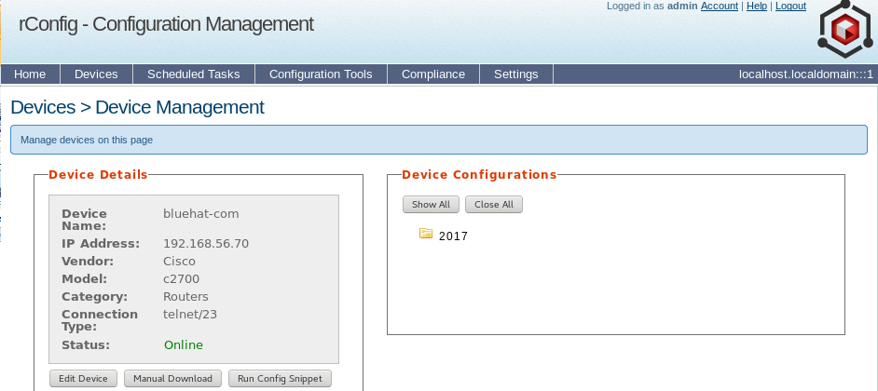

Slide 48
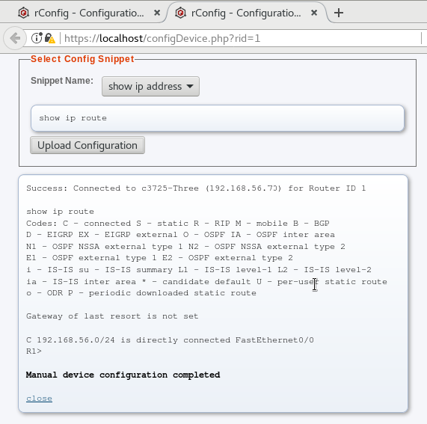
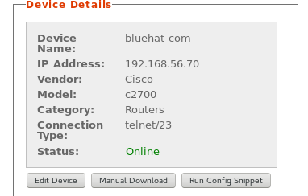
Run Config Snippet
Pops up the snippet
Screen and
Choose snippet name

Slide 49
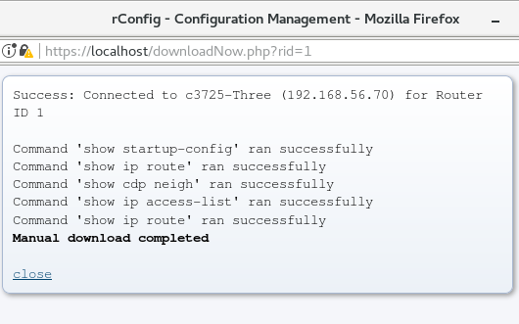
Manual Download
Pops up manual downloads and runs the
Commands created for the router category

Slide 50
SSH Connection
Red colored text is your wish
conf t
Int f0/0
Ip add 192.168.56.10 255.255.255.0
no shut
username vinod password test123
ip domain-name tedhat.com
crypto key generate rsa
[ Enter Bits Value as : 1024 ]
line vty 0 4
transport input ssh
login local
exit

Slide 51
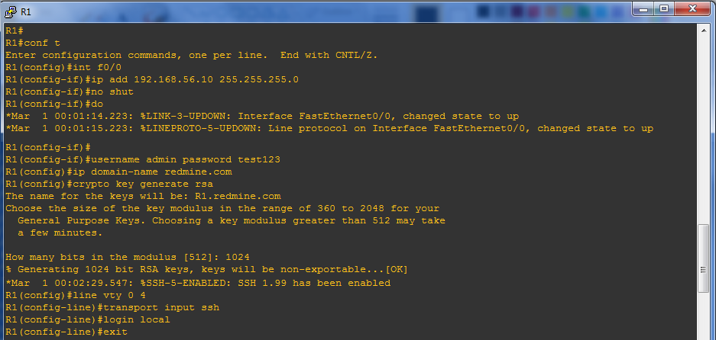
Router Connection using SSH2

Slide 52
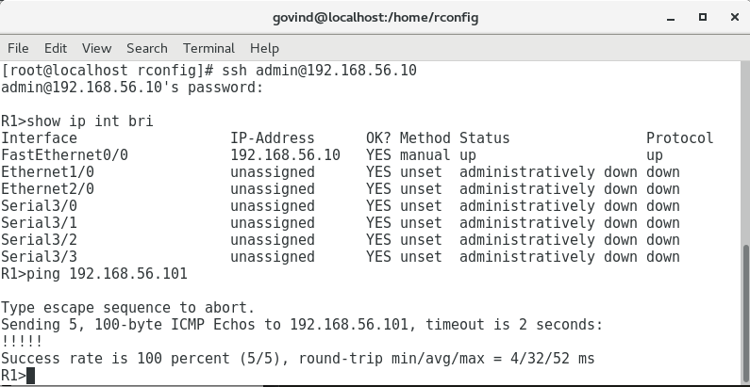
CentOS Terminal Verification

Slide 53

test123

Slide 54



Slide 55


